Slide 1
Intern Presentation
21 Jul 2023
Chan Ming Han
Attached to: RA, RB / AAR
Supervisors: Lionel, Benson

Slide 2

About me
Year 2 student (Renaissance Engineering Programme, NTU)
Specialising in Computer Engineering, keen interests in the FinTech space and drones!
Going to UC Berkeley for exchange this August, hoping to explore the world, and further my knowledge Computer Science related modules.

Slide 3
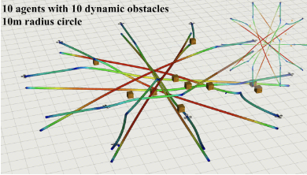
Background of Project
MIT Publication: Robust – MADER
Decentralized and Asynchronous Multiagent Trajectory Planner Robust to Communication Delay
Algorithm based on MADER which was robust to communication delays, and guaranteed to be 100% collision free
Fig[1]: 10 Agents with 10 dynamic obstacles with RMADER Algorithm

Slide 4
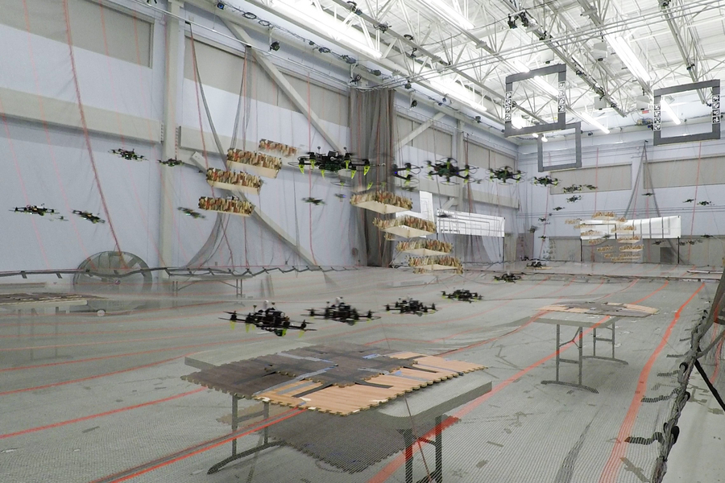
Background of Project
MIT Publication: Robust – MADER
Decentralized and Asynchronous Multiagent Trajectory Planner Robust to Communication Delay
Algorithm based on MADER which was robust to communication delays, and guaranteed to be 100% collision free
Fig[1]: 10 Agents with 10 dynamic obstacles with RMADER Algorithm
MADER: A trajectory planning system that enables drones working together in the same airspace to always choose a safe path forward
Fig[2]: MADER Simulation of Drone in real environment

Slide 5
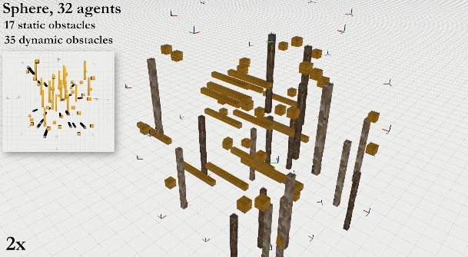
Value of MADER
Asynchronous and Decentralized
Fig[3]: Spherical configuration of 32 Agents with dynamic obstacles
Plan
Optimization
Check
Notes:
Asynchronous and Decentralized: This means that each drone formulates its own trajectory and that, while all agents must agree on each new trajectory, they don’t need to agree at the same time. This makes MADER more scalable than other approaches, since it would be very difficult for thousands of drones to agree on a trajectory simultaneously. Due to its decentralized nature, the system would also work better in real-world environments where drones may fly far from a central computer. This also means that there is no single point of failure, making the system more reliable.

Slide 6
Value of MADER
Asynchronous and Decentralized
Plan
Optimization
Check
Find a possible trajectory. Trajectories of the agent are not committed currently.
Search Algorithm Used: Octopus Search
Includes all polyhedral representations of the trajectories in the constraints. All trajectories other agents commit to are stored.
To check whether the trajectory found in the optimization step collides with trajectories that other agents have committed to during the optimization.

Slide 7
Value of MADER
Asynchronous and Decentralized
Plan
Optimization
Check
Find a possible trajectory. Trajectories of the agent are not committed currently.
Search Algorithm Used: Octopus Search
Includes all polyhedral representations of the trajectories in the constraints. All trajectories other agents commit to are stored.
To check whether the trajectory found in the optimization step collides with trajectories that other agents have committed to during the optimization.
Key Assumption: Perfect Communication
Notes:
Communication delays can be catastrophic for multiagent systems. However, most existing state-of-the-art multiagent trajectory planners assume perfect communication and therefore lack a strategy to rectify this issue in real-world environments.

Slide 8
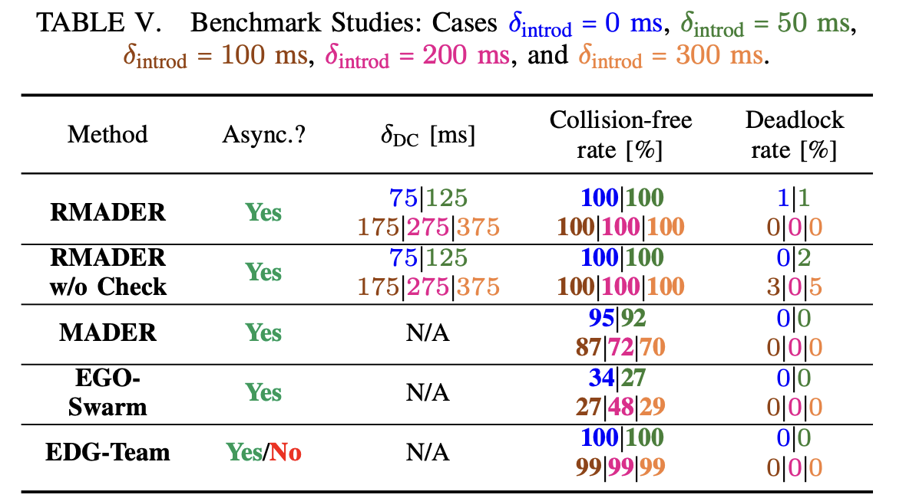
Value of RMADER
Plan
Optimization
Check
Delay Check
Find a possible trajectory. Trajectories of the agent are not committed currently.
Search Algorithm Used: Octopus Search
Includes all polyhedral representations of the trajectories in the constraints. All trajectories other agents commit to are stored.
To check whether the trajectory found in the optimization step collides with trajectories that other agents have committed to during the optimization.
Agent keeps receiving trajectories from other agents and storing them, repeatedly checking if its newly optimized trajectory is conflicting.
Figure[4]: Benchmark Studies
Kondo, K. (2023, March 10). Robust MADER: decentralized multiagent trajectory planner robust to communication delay in dynamic environments. arXiv.org. https://arxiv.org/abs/2303.06222
Notes:
Communication delays can be catastrophic for multiagent systems. However, most existing state-of-the-art multiagent trajectory planners assume perfect communication and therefore lack a strategy to rectify this issue in real-world environments.

Slide 9
Problem Statement
To evaluate the performance of RMADER for autonomous flight, emulated by simulations done in ROS on Ubuntu 20.06.

Slide 10
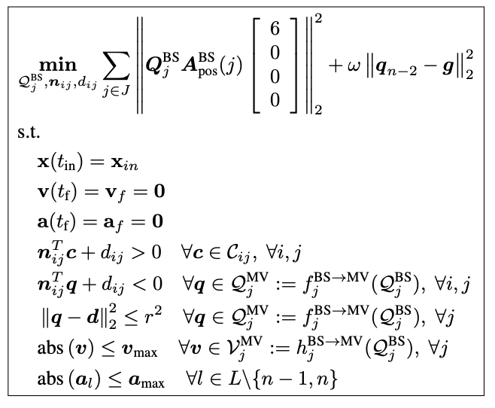
The Optimization Problem
Initial & Final States
x: Position
v: Velocity
a: Acceleration
Collision-free constraints
Penalty Cost for distance from end goal
Actuator and Physical constraints
Fig[5]: Optimization Problem
Tordesillas, J. (2020, October 21). MADER: trajectory planner in multi-agent and dynamic environments. arXiv.org. https://arxiv.org/abs/2010.11061
Notes:
Restriction of initial and final states and constraints allow for optimization to remain convex, saving on computational expense.

Slide 11
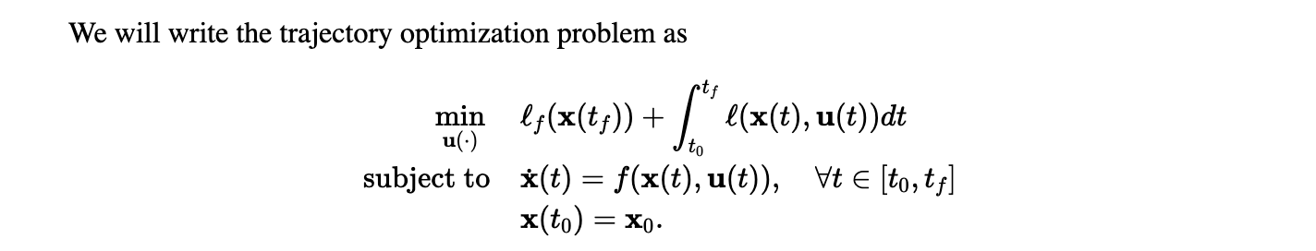

General Approach
Constrained Optimization Problem
Fig[6]: General Form of Optimization Problem
Tedrake, R. Ch. 10 - Trajectory Optimization. (n.d.). http://underactuated.mit.edu/trajopt.html
Hardware Requirements
INTEL NUC 10
64GB RAM

Slide 12
General Approach
Constrained Optimization Problem
Unconstrained Optimization
GCOPTER: An optimization-based framework for multicopter trajectory planning, developed on novel optimality conditions for unconstrained control effort minimization.
Fig[6]: General Form of Optimization Problem
Tedrake, R. Ch. 10 - Trajectory Optimization. (n.d.). http://underactuated.mit.edu/trajopt.html
Hardware Requirements
INTEL NUC 10
64GB RAM
Notes:
Put GCOPTER workings in the appendix!

Slide 13
Revised Problem Statement
To compare and benchmark the performance of RMADER against GCOPTER for autonomous flight, emulated by simulations done in ROS on Ubuntu 20.06.

Slide 14
Setup of Test Space
Was found that performance of the path planner depended heavily on the computational resources available, as well as the number of discretization intervals.
Test was conducted over a Euclidean distance of ~30m
(-10, 10, 0) → (10, -10, 0)
Maze was set to be the same over 50 simulations for both GCOPTER and RMADER
Optimization in RMADER used the NLOPT Solver
Default settings for RMADER: 100 discretization Intervals
Default Settings for GCOPTER: 16 Discretization Intervals
Notes:
Default settings weighted based on the length of the path

Slide 15
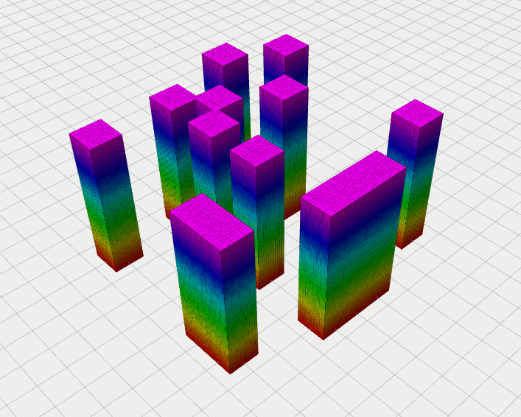
Setup of Emulation Environment
RMADER: CGAL Library
GCOPTER: mockamap Library
Identical maps created in both libraries using a random seed (123)
Emulation carried out in ROS, visualized using RViz
Test automation script written in bash to execute n=50 runs per simulation.
Fig[6]: Obstacle Setup (RViz)
Notes:
Drones to be emulated also had identical constraints (ie velocity limit, acceleration limit, mass)

Slide 16
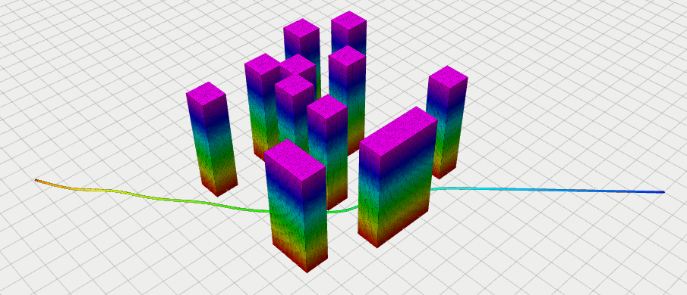
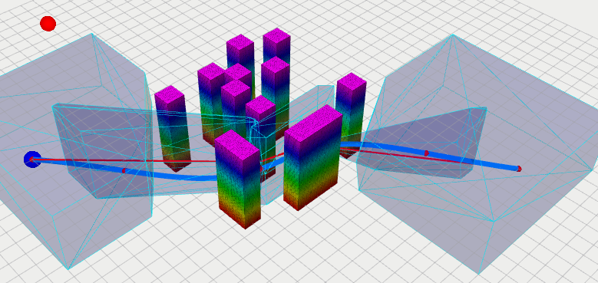
Path Planner (RViz)
RMADER
GCOPTER
(10, -10, 0)
(10, -10, 0)
(-10, 10, 0)
(-10, 10, 0)
Fig[7]: Path Generated by RMADER (RViz)
Fig[7]: Path Generated by GCOPTER (RViz)
Notes:
Relative Standard Deviation

Slide 17
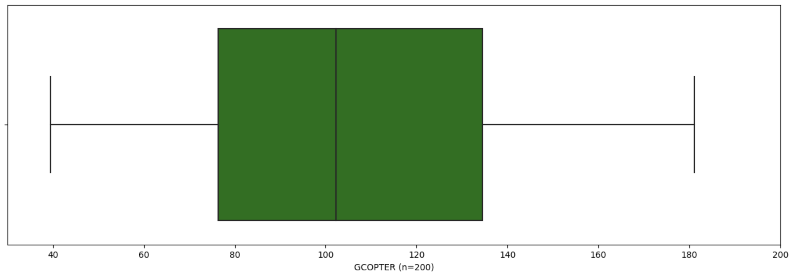
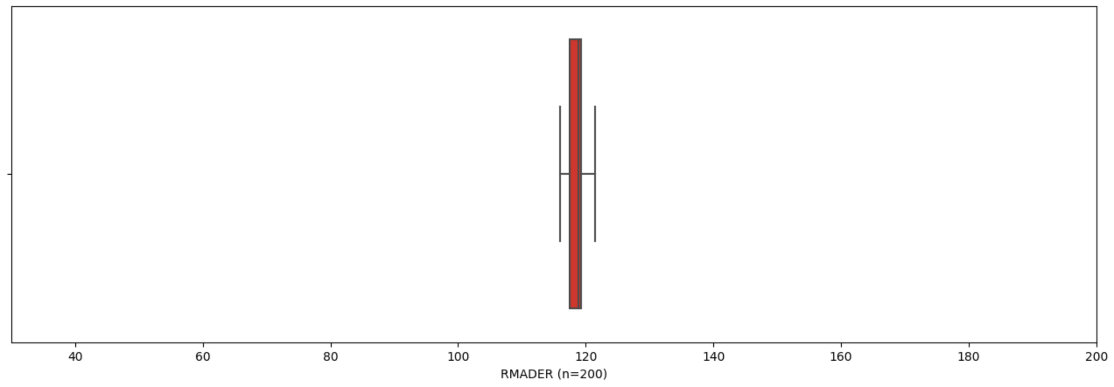
RMADER vs GCOPTER Performance (Spread)
Notes:
Relative Standard Deviation

Slide 18
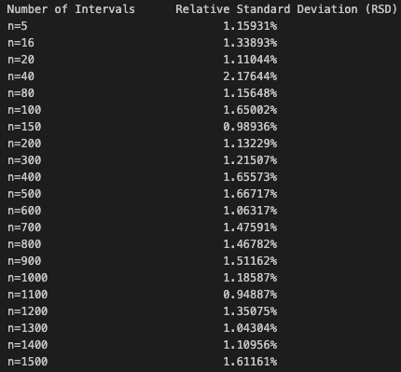
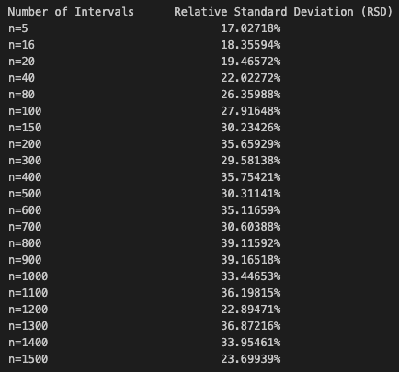
RMADER vs GCOPTER Performance (RSD)
RMADER
GCOPTER
Notes:
Relative Standard Deviation

Slide 19
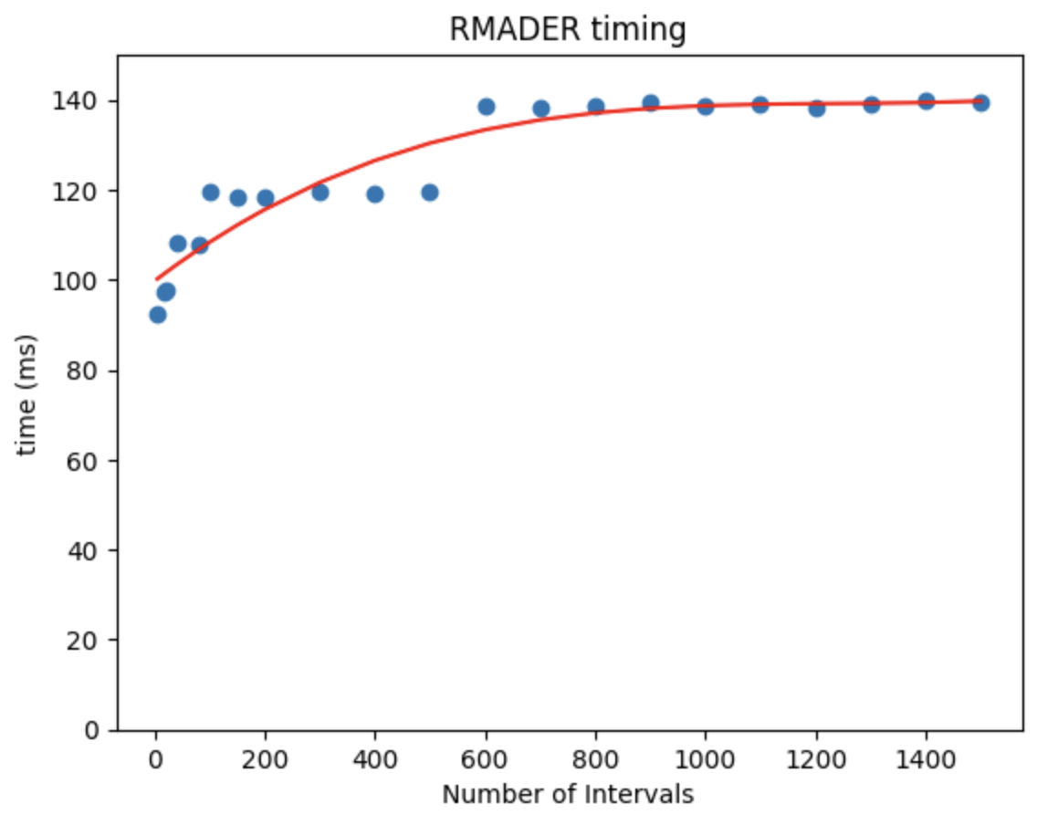
RMADER Performance
Observations
Positive, non-linear relationship between time and numIntervals
Noticeable ”step-ups” at n=40, n=100 and n=600 (Elaborated in Appendix C2)
“Step-ups” attributed to manual method of finding the max Runtime for the RMADER algorithm
Notes:
Explain the derivation of runtime for RMADER in this slide

Slide 20
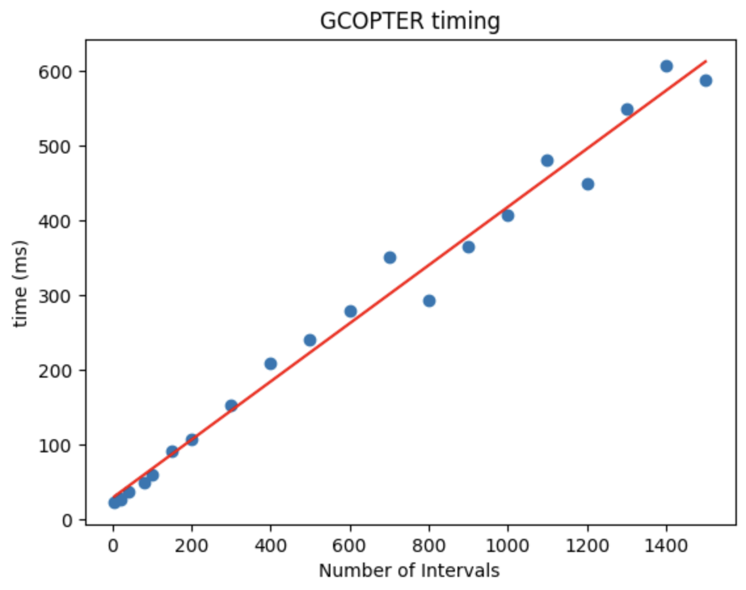
GCOPTER Performance
Observations
Strong, Positive, Linear relationship between time and numIntervals
Pearson Correlation Coefficient = 0.993
Notes:
Relative Standard Deviation

Slide 21
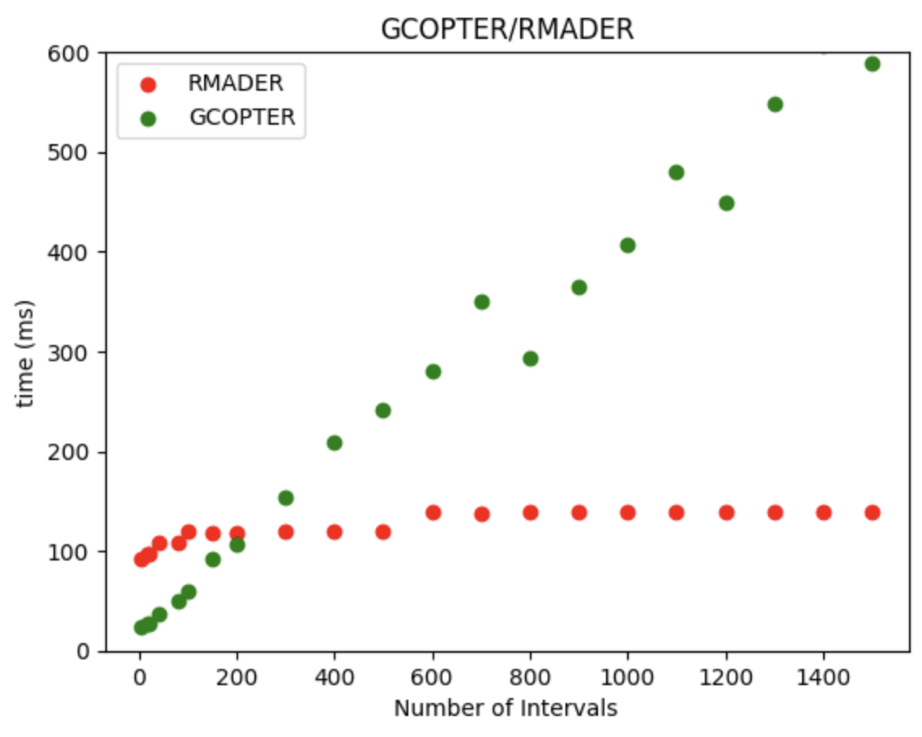
Comparison of Performance
Observations
GCOPTER shows a much larger rate of increase of time as numIntervals increases, compared to RMADER.
GCOPTER has better performance up till n = 200.
Notes:
Relative Standard Deviation

Slide 22
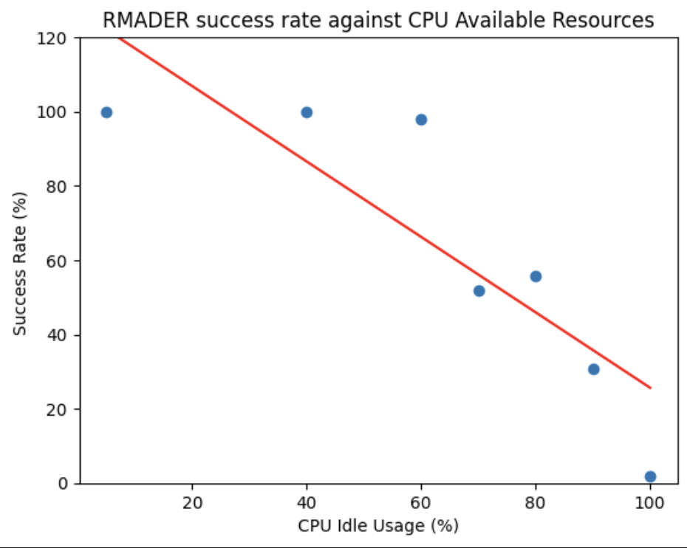
Performance of RMADER (CPU)
Use an infinite while loop in a bash terminal to consume CPU resources
Gradient = -1.015

Slide 23
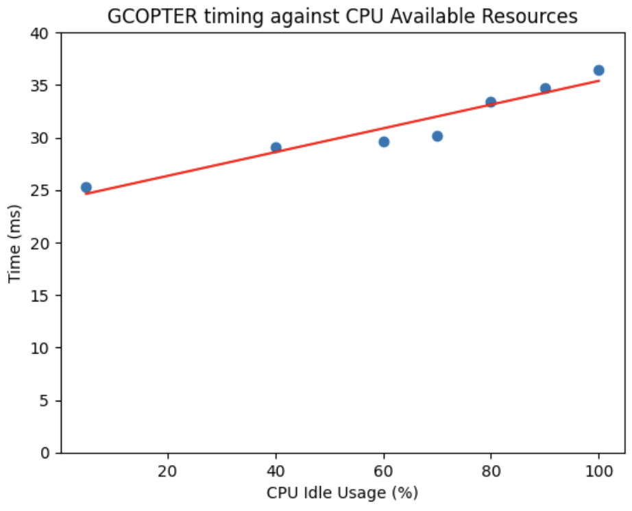
Performance of GCOPTER (CPU)
Unsuitable direct comparison due to GCOPTER performance being measured in time, while RMADER performance being measured in success rate.
Idea: Find a suitable (not necessarily entirely accurate) of Time to success rate.
Utilize relationship: time inversely proportional to success rate
Scale up the graph to the same scale as RMADER
Notes:
Transformations:
Utilize relationship → time is inversely proportional to success rate
Scale up to fit graph to appropriate scale for comparison with RMADER

Slide 24
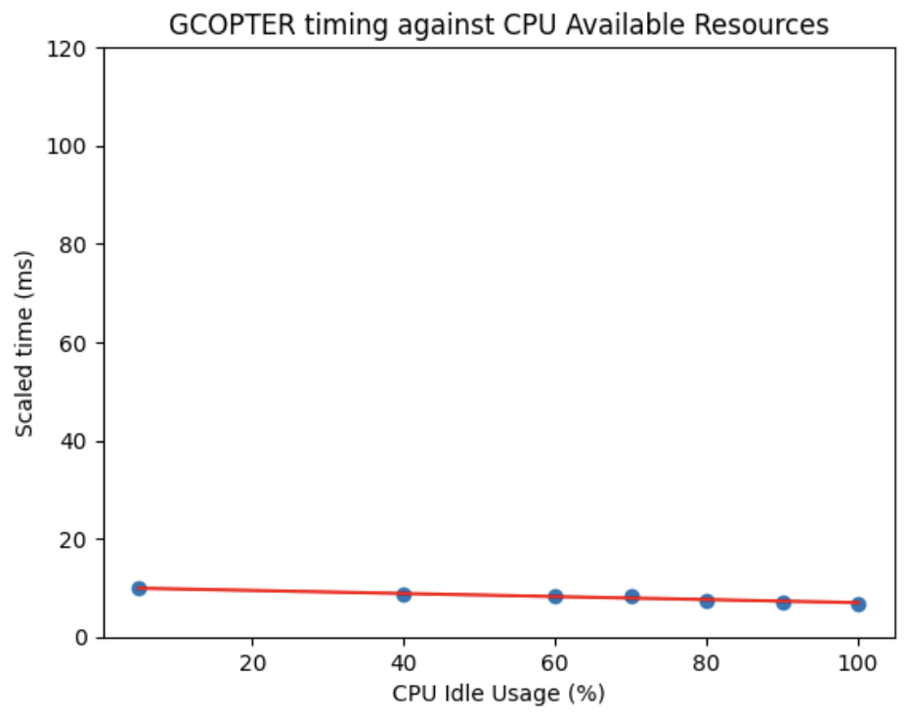
Comparison of Performance (CPU)
Gradient = -0.00012365
Gradient = -1.015
Notes:
Transformations:
Utilize relationship → time is inversely proportional to success rate
Scale up to fit graph to appropriate scale for comparison with RMADER

Slide 25
Comparison of Performance (CPU)
RMADER is more prone to failure when computational resources
are low as compared to GCOPTER.
Gradient = -0.00012365
Gradient = -1.015
Notes:
Transformations:
Utilize relationship → time is inversely proportional to success rate
Scale up to fit graph to appropriate scale for comparison with RMADER

Slide 26
Evaluation
Both RMADER and GCOPTER’s performance decayed as the number of discretization intervals increased.
GCOPTER’s performance decayed at a greater rate compared to RMADER.
GCOPTER performs better with low number of discretization intervals (n<200) as compared to RMADER.
Discretization Intervals

Slide 27
Evaluation
Both RMADER and GCOPTER’s performance decayed as the number of discretization intervals increased.
GCOPTER’s performance decayed at a greater rate compared to RMADER.
GCOPTER performs better with low number of discretization intervals (n<200) as compared to RMADER.
Both RMADER and GCOPTER’s performance decayed as the percentage of CPU Available Resources decreases.
GCOPTER’s performance decayed at a much slower rate as compared to RMADER.
With limited CPU resources, GCOPTER seems to be more robust to failure.
Discretization Intervals
CPU Available Resources

Slide 28
Future Work
Shortcomings of current work | Recommendations
RMADER had to be manually tuned to find the runtime which would allow for complete path generation. | Edit the internal code within the nlopt-solver to exit the exit the code only when the destination is found (ie no timeout).
CPU Resources could not be precisely tuned. Only managed to approximately increase/decrease CPU usage by running an infinite bash script. | Emulate the algorithms on a machine where CPU resources can be precisely tuned.

Slide 29
Future Work
Expand the test space to include different start / end points.
Expand the test space to include different maps.
Inclusion of dynamic obstacles.
Using a machine learning model to determine the best level of discretization for a given distance.
EGO-Planner-v2 (Swarm of micro flying robots in the wild)
RMADER was benchmarked against EGO-Swarm, with promising results. EGO-Planner-v2 is the upgraded swarm planner by ZJU-FAST-Lab.
To determine the ideal level of discretization for optimal performance of the algorithms
To do a comparison of RMADER with the swarm implementation of GCOPTER

Slide 30
Challenges
Challenge | How they were overcome
Difficult to quantify the minimum time to generate a complete path in RMADER due to random environment factors and timeout issue. | Run the RMADER algorithm over 50 simulations and determine the success rate.
Trying to understand the complex mathematics and code behind the GCOPTER and RMADER algorithms. | Referring to modules online on optimization and control to gain insight into the different optimization strategies and path planning methods.

Slide 31
Reflections
Interesting and fun project to work on
Researching on novel technology with sparse documentation and minimal support from the online community meant that understanding fundamentals became very important.
Learned how to break tasks up into more bite-sized and manageable pieces.

Slide 32
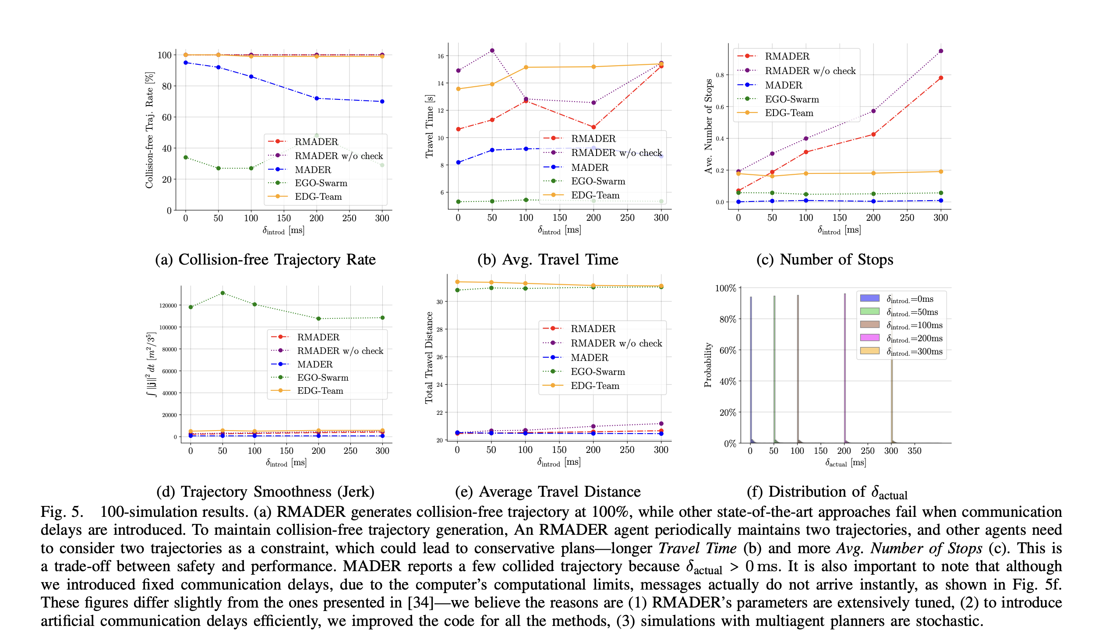
Appendix A
RMADER benchmark against other path planning algorithms

Slide 33
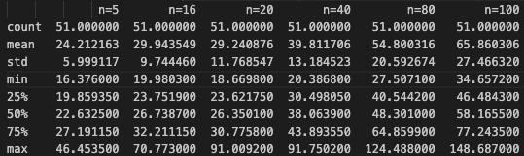
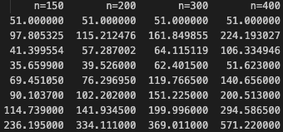
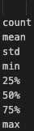
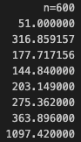
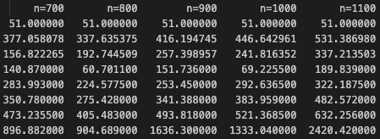
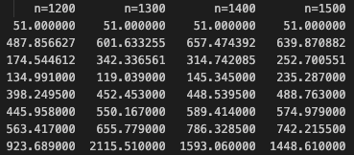
Appendix B1
GCOPTER Summary Statistics

Slide 34
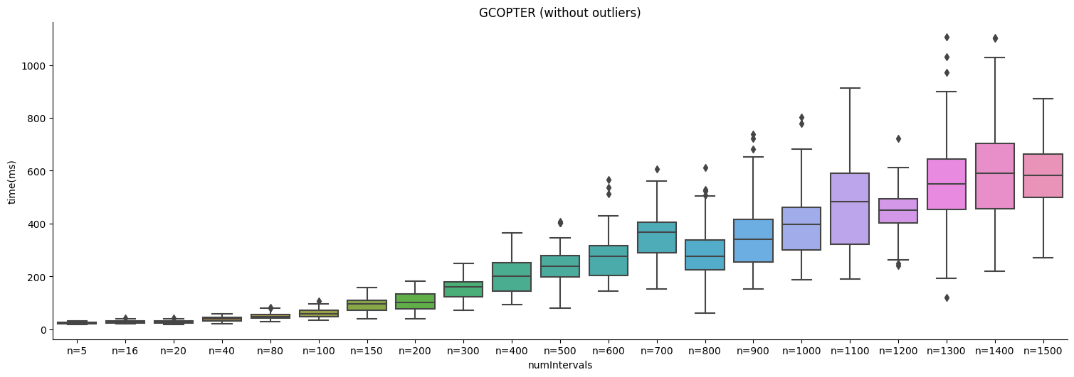
Appendix B2
GCOPTER Box Plot by numIntervals

Slide 35
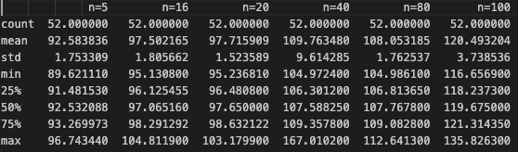
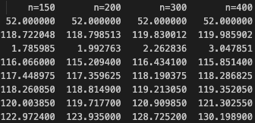
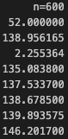
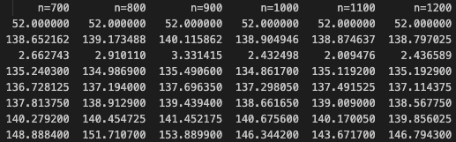
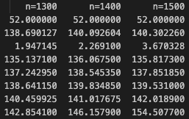
Appendix C1
RMADER Summary Statistics

Slide 36
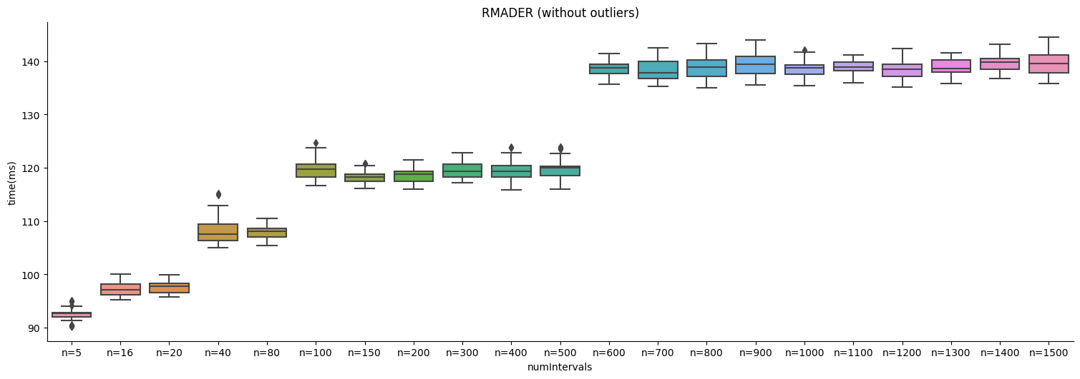
Appendix C2
RMADER Box Plot by numIntervals

Slide 37
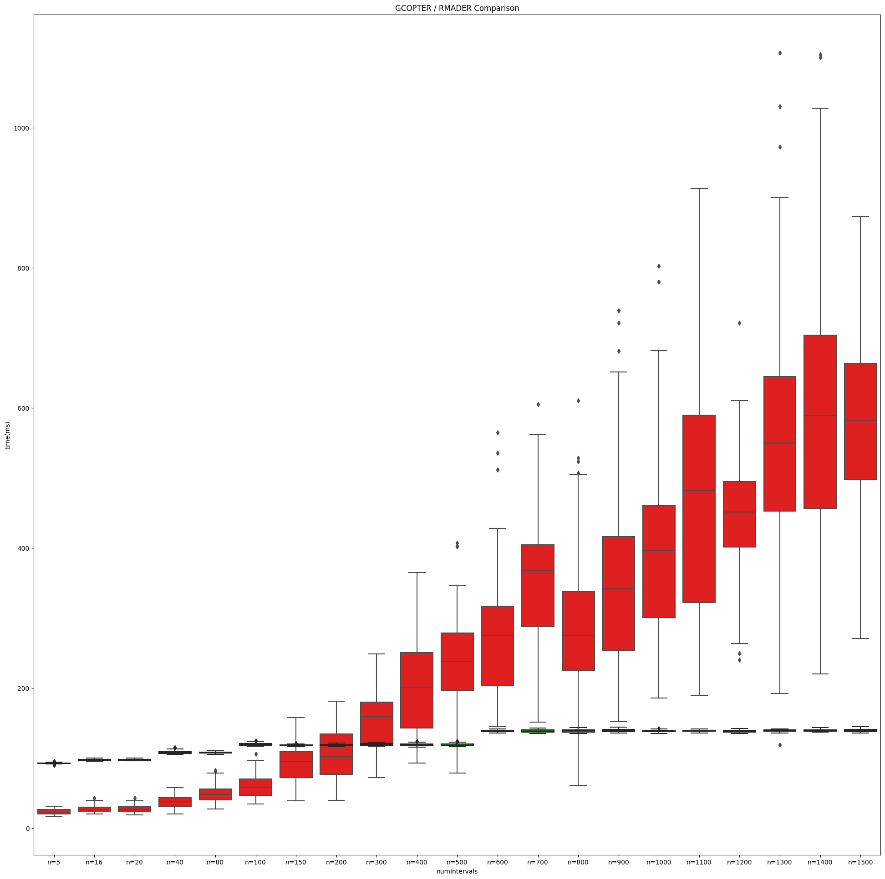
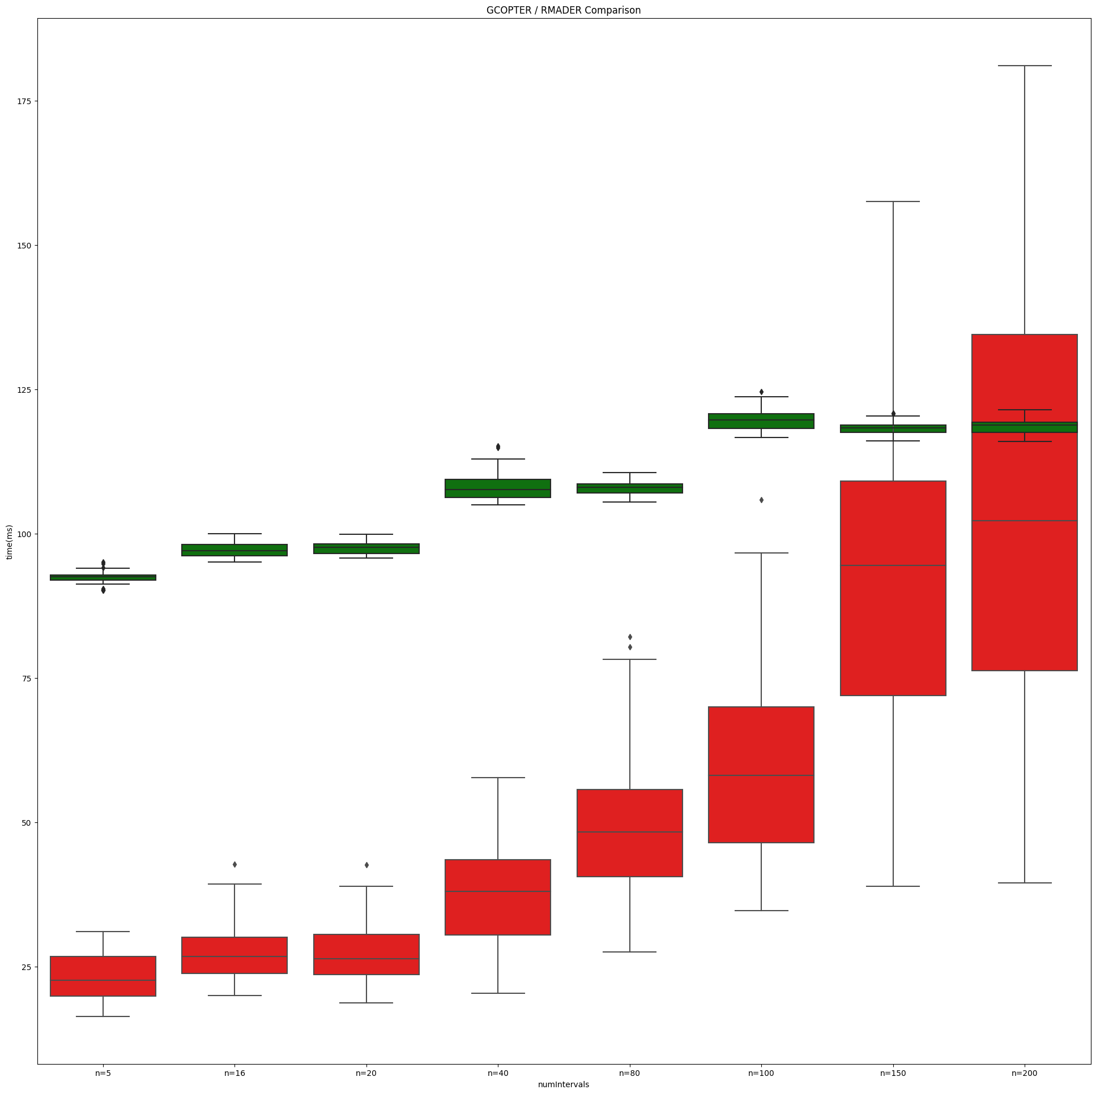
Appendix D
Box plot comparison of RMADER / GCOPTER

Slide 38
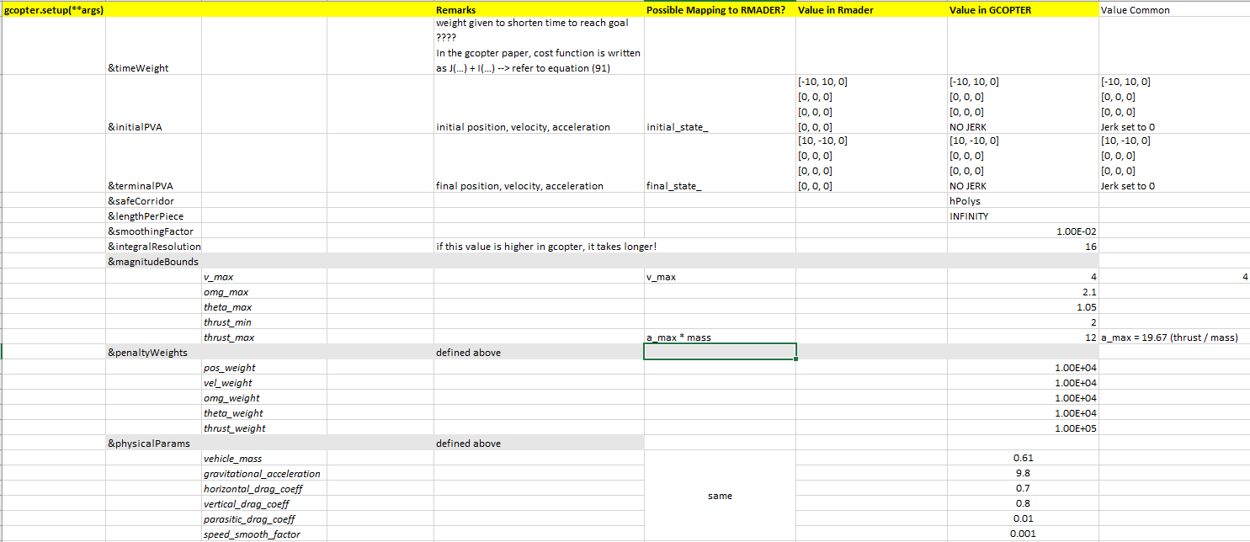
Appendix E
Configuration for planner setup

Slide 39
Appendix F
Simulation Environment vs RMADER Deployment Environment
Emulation Environment
11th Gen Intel(R) Core(TM) i7-1165G7 @ 2.80GHz 1.69 GHz
16.0 GB RAM
X64 based processor
RMADER Hardware
Intel® Core™ i5-10210U Processor (6M Cache, up to 4.20 GHz)
64GB RAM

Slide 40
References
New algorithm keeps drones from colliding in midair. (2023, March 29). MIT News | Massachusetts Institute of Technology. https://news.mit.edu/2023/new-algorithm-keeps-drones-colliding-midair-0329
Ch. 10 - Trajectory Optimization. (n.d.-b). http://underactuated.mit.edu/trajopt.html
Kondo, K. (2023, March 10). Robust MADER: decentralized multiagent trajectory planner robust to communication delay in dynamic environments. arXiv.org. https://arxiv.org/abs/2303.06222
Tordesillas, J. (2020, October 21). MADER: trajectory planner in multi-agent and dynamic environments. arXiv.org. https://arxiv.org/abs/2010.11061

